Slide 1

Flutter

Slide 2
Lab Task 1

Slide 3
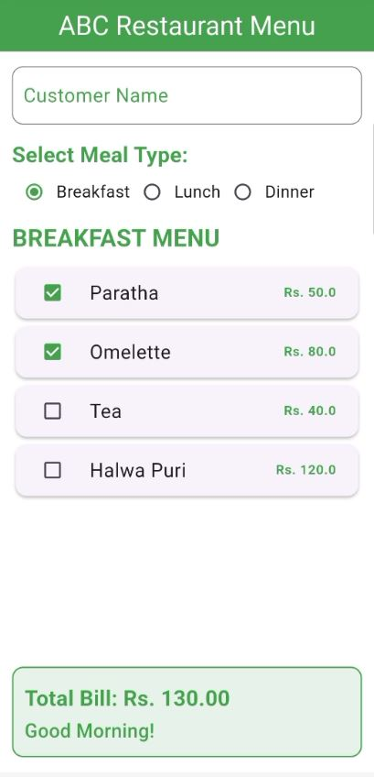
Lab Task 1
ABC Restaurant wants a single-screen app where customers can select between Breakfast, Lunch, or Dinner. Once a meal type is selected, the menu for that category appears. Customers can select multiple food items, and the total bill will be calculated and displayed dynamically.
Meal Type choice
Auto Label changing
Display menu in a list view from list
Auto Bill calculation.
Auto Label changing (Change on radio button selection)

Slide 4
Lab Task 2

